Slide 1
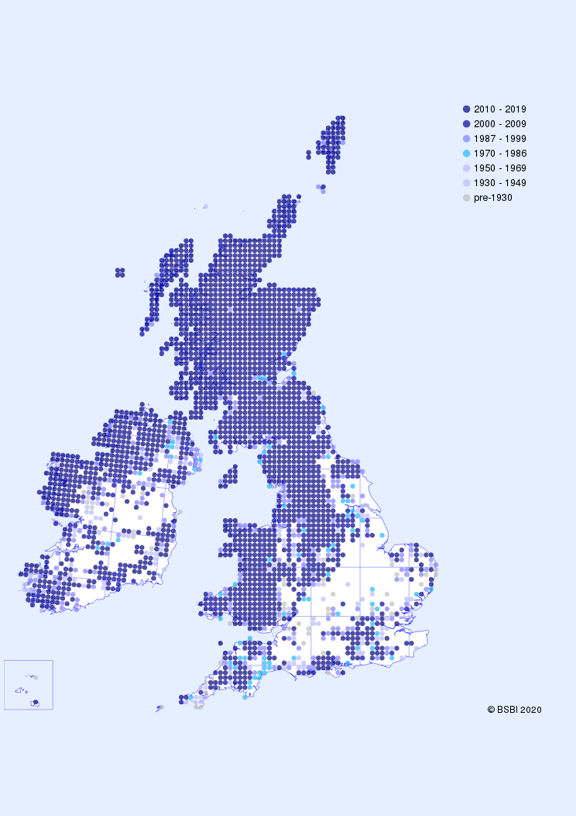
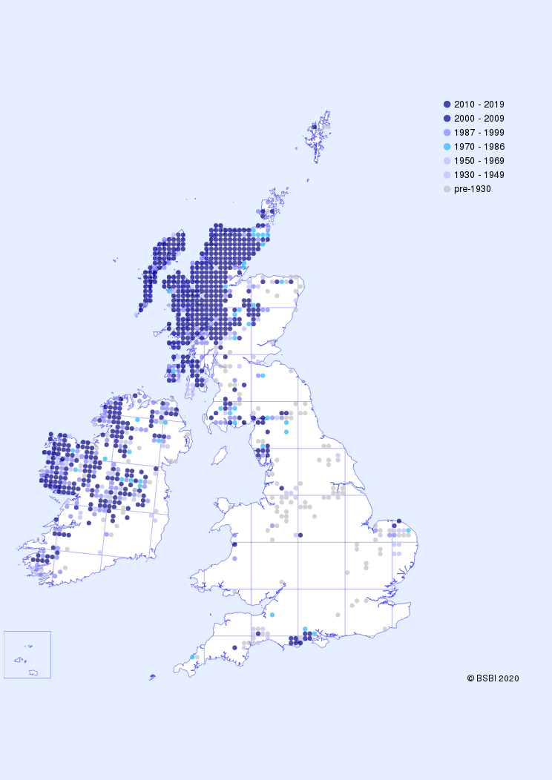
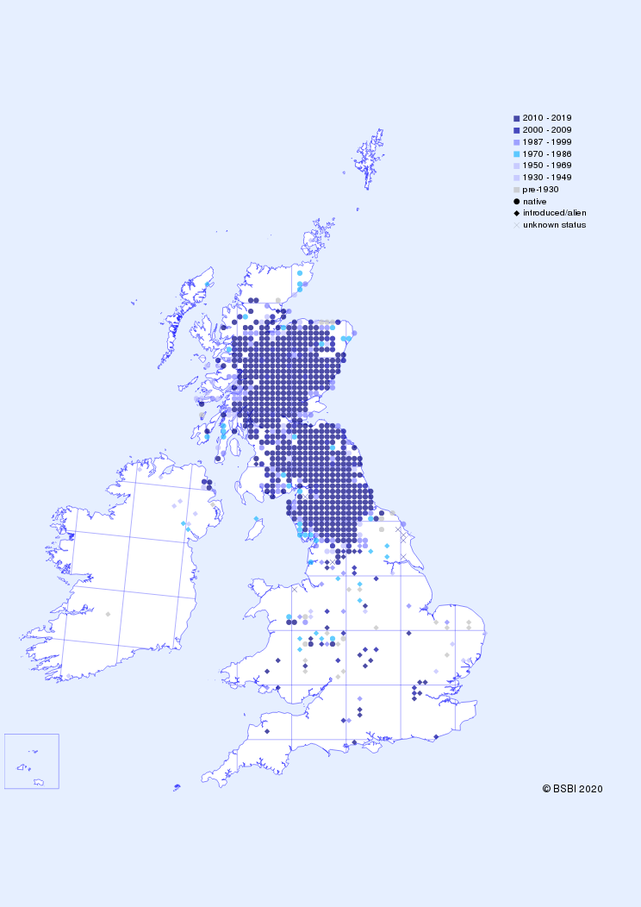
Hectad date classes (colours TBC)
Nardus stricta
Drosera anglica
Geranium sylvaticum (note status)

Slide 2
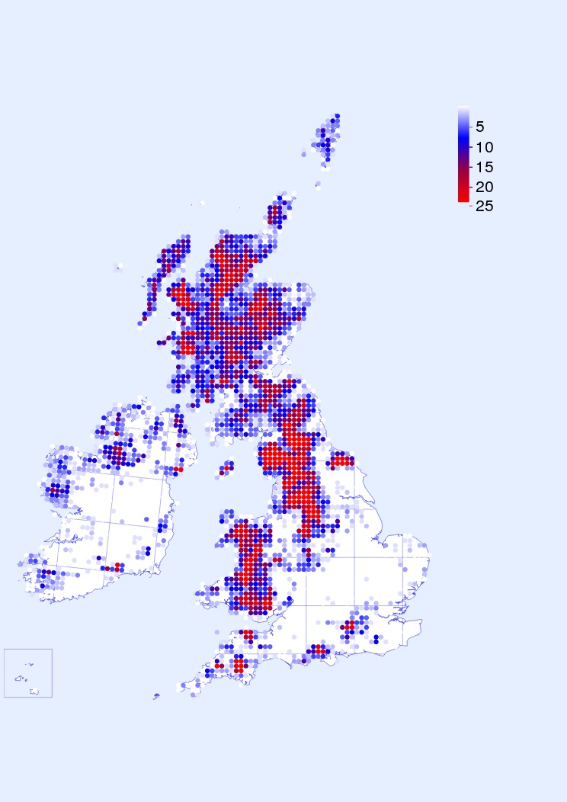
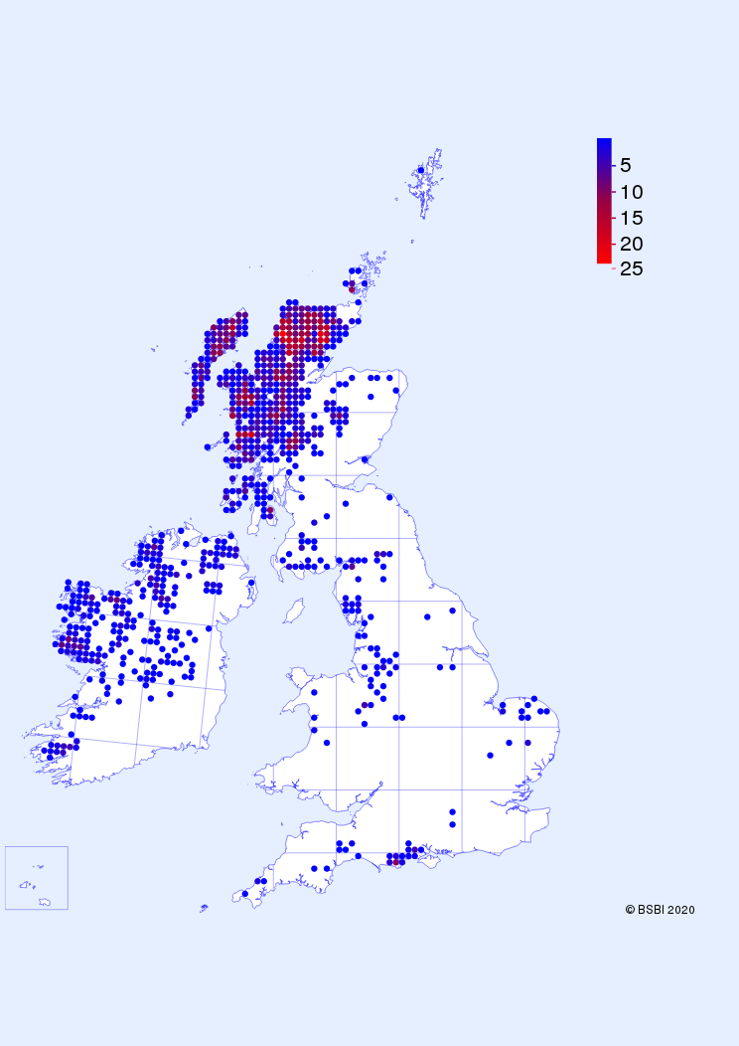
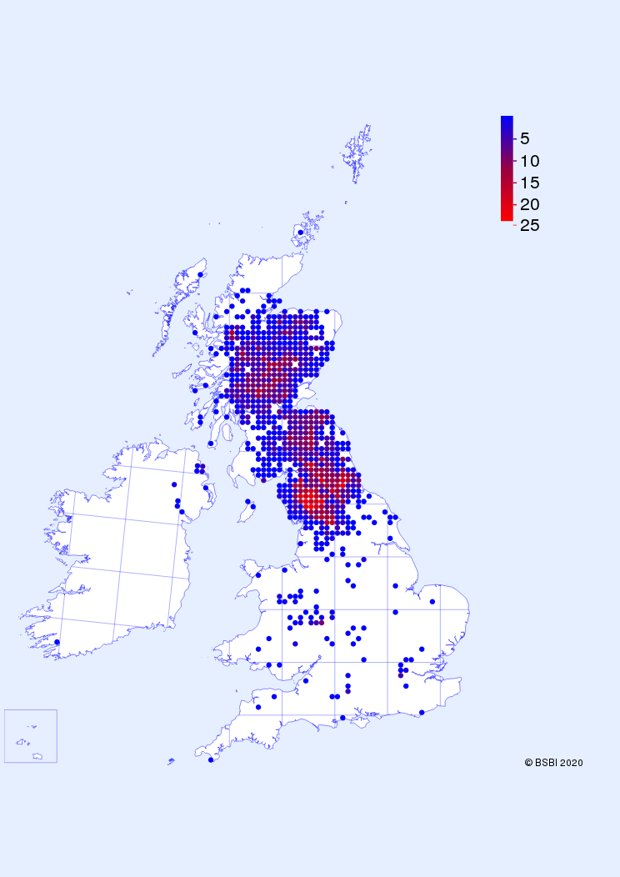
Tetrad frequency within hectad
Nardus stricta
Drosera anglica
Geranium sylvaticum

Slide 3
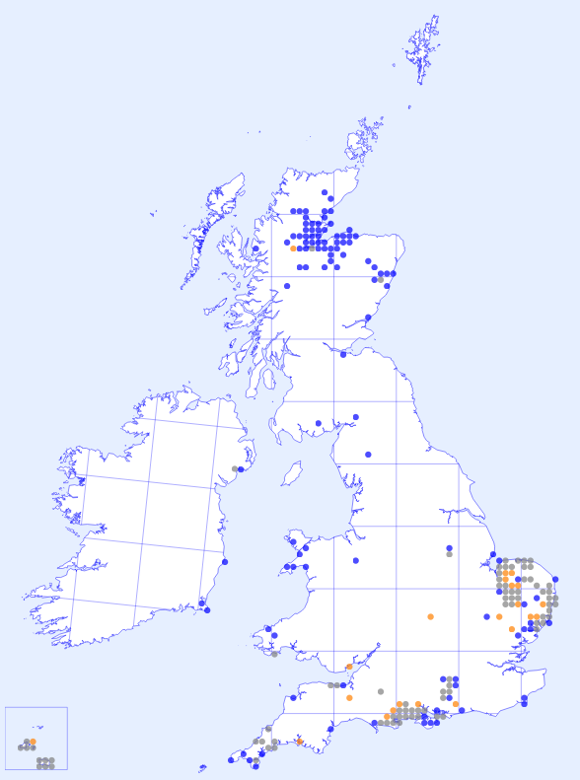
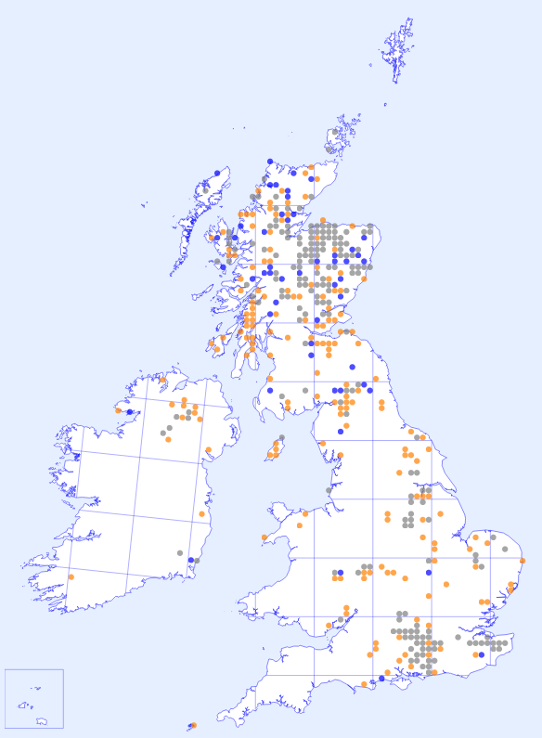
Hectad change 1987-99 vs 2000-19
= unchanged 1987-2018
= not recorded post-1999
= new post-1999
Crassula tillea
Gnaphalium sylvaticum

